Slide 1
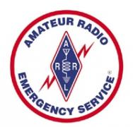
Amateur Radio and Emergency Communications
Greg Schwab – Georgetown Fire Chief
Jay Harmor – Senior Developer, VSP
Bob Hess – Director, Operations/Engineering/IT, CBS13 / CW31
El Dorado County ARC - www.edcarc.net

Slide 2
Amateur Radio and Emergency Communications
What is Amateur Radio?
It’s a worldwide hobby involving communications and radio
It requires a license
In the USA, it is regulated by the Federal Communications Commission
You must pass a test to obtain a license
Currently 717,200 Hams in the USA and Growing
El Dorado County ARC - www.edcarc.net

Slide 3
Amateur Radio and Emergency Communications
Who are the Radio Hams?
Ham operators come from virtually all walks of life
Lawyers
Doctors
Engineers
Law Enforcement and Fire Personnel
Union Organizers
Scouts
Military
Astronauts
Politicians
El Dorado County ARC - www.edcarc.net

Slide 4
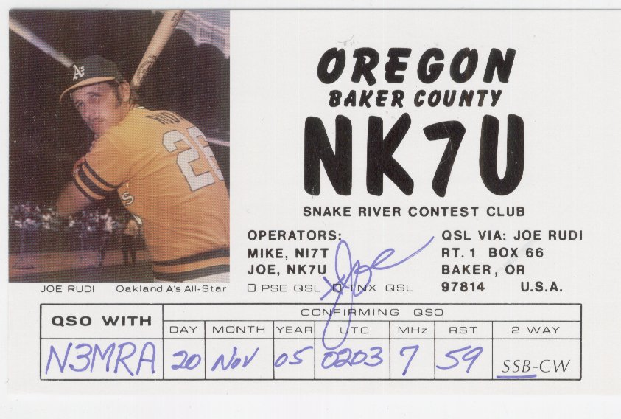
Amateur Radio and Emergency Communications
Did you know….?
El Dorado County ARC - www.edcarc.net

Slide 5
Amateur Radio and Emergency Communications
Did you know….?
El Dorado County ARC - www.edcarc.net

Slide 6
Amateur Radio and Emergency Communications
Did you know….?
El Dorado County ARC - www.edcarc.net

Slide 7
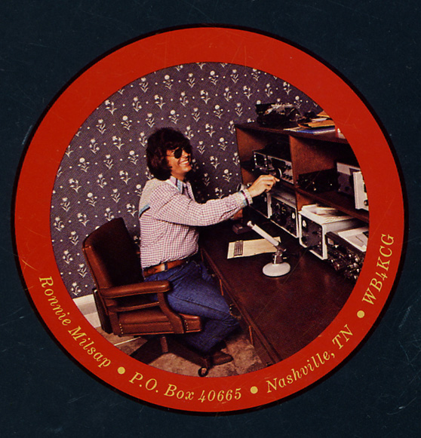
Amateur Radio and Emergency Communications
Did you know….?
El Dorado County ARC - www.edcarc.net

Slide 8
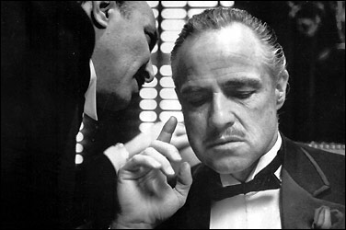
Amateur Radio and Emergency Communications
Did you know….?
Marlon Brando
El Dorado County ARC - www.edcarc.net

Slide 9
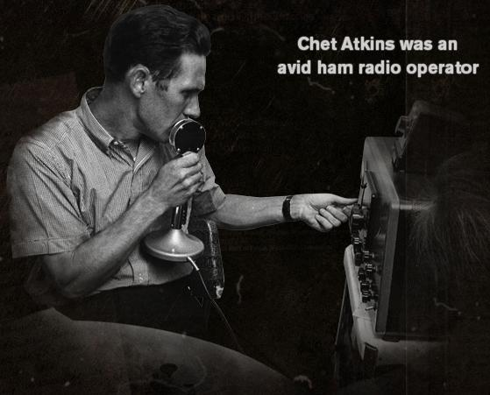
Amateur Radio and Emergency Communications
Did you know….?
El Dorado County ARC - www.edcarc.net

Slide 10
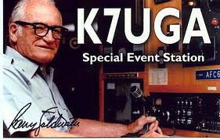
Amateur Radio and Emergency Communications
Did you know….?
El Dorado County ARC - www.edcarc.net

Slide 11
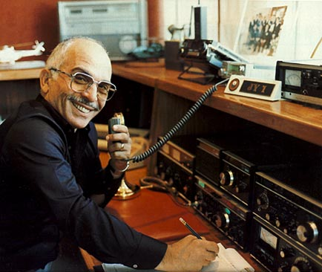
Amateur Radio and Emergency Communications
Did you know….?
King Hussein, Jordan
El Dorado County ARC - www.edcarc.net

Slide 12
Amateur Radio and Emergency Communications
Did you know….?
Paul Tibbits
Donnie Osmond
Priscilla Presley
Howard Hughes
Yuri Gagarin
El Dorado County ARC - www.edcarc.net

Slide 13
Amateur Radio and Emergency Communications
Did you know….?
El Dorado County ARC - www.edcarc.net

Slide 14
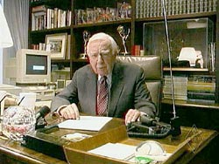
Amateur Radio and Emergency Communications
Did you know….?
El Dorado County ARC - www.edcarc.net

Slide 16
Amateur Radio and Emergency Communications
El Dorado County Amateur Radio Club
Event Communication
Parades
Races
Walks
El Dorado County ARC - www.edcarc.net

Slide 17
Amateur Radio and Emergency Communications
The El Dorado County Amateur Radio Club Radio System
Mt Danaher
Bald Mountain (Georgetown)
Pine Hill (Rescue)
Hotchkiss Hill (Georgetown)
Alder Ridge (Kyburz)
Sacramento Hill (Placerville)
Omo Ranch
Crystal Blvd (El Dorado)
Lotus
El Dorado County ARC - www.edcarc.net

Slide 18
Amateur Radio and Emergency Communications
El Dorado County ARC - www.edcarc.net

Slide 19
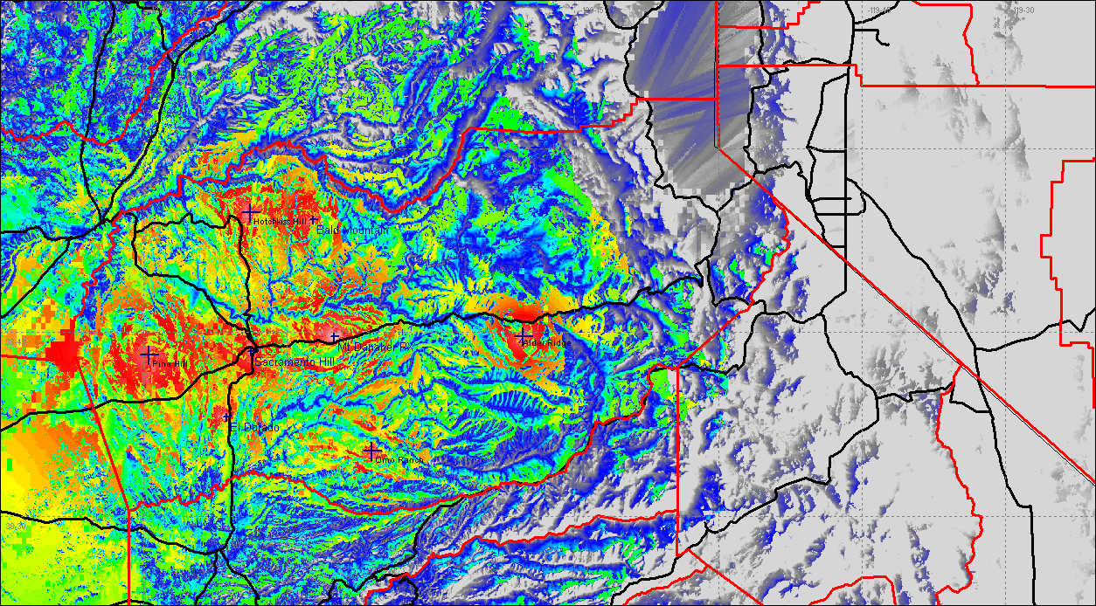
Amateur Radio and Emergency Communications
El Dorado County ARC - www.edcarc.net

Slide 20
Amateur Radio and Emergency Communications
Verizon
EDCARC
El Dorado County ARC - www.edcarc.net

Slide 21
Amateur Radio and Emergency Communications
When the Power Goes Out…
When the Cell Sites Go Down…
When the Phones Don’t Work…
El Dorado County ARC - www.edcarc.net

Slide 22
Amateur Radio and Emergency Communications
Amateur Radio is Always There
El Dorado County ARC - www.edcarc.net

Slide 23
Amateur Radio and Emergency Communications
Amateur Radio Emergency Service® (ARES)
The Amateur Radio Emergency Service® (ARES) consists of licensed amateurs who have voluntarily registered their qualifications and equipment, with their local ARES leadership, for communications duty in the public service when disaster strikes.
El Dorado County ARC - www.edcarc.net

Slide 24
Amateur Radio and Emergency Communications
What do ARES members do?
Use communications skills to pass messages and information
Provide resources and skills and local knowledge to local agencies.
Provide additional resources to other ARES groups.
Who does the El County ARES support?
CALFIRE VIP program (sometimes)
Marshall Hospital
American Red Cross
Large Animal Rescue
El Dorado County ARC - www.edcarc.net

Slide 25
Amateur Radio and Emergency Communications
Why do we need to provide communications? First responders have radios and everyone has cell phone.
First Responders (Sherriff / Fire) are dealing with the event in progress and may not have the time to pass the types of information that an ARES group would handle.
Cell sites typically have a range of 21 miles in open terrain and as little as 3 miles in hilly terrain.
El Dorado County ARC - www.edcarc.net

Slide 26
Amateur Radio and Emergency Communications
During an emergency cell sites become overwhelmed in the event area.
New connections not accepted and calls dropped.
Cell sites are limited by bandwidth to around 150-200 calls per second.
Texting better in an emergency uses less bandwidth and messages are queued until they can be sent.
Last summer the fire in Shingle Springs along Highway 50 the cell sites in the area hit capacity and motorists stranded on the Highway could not make calls.
Cell phones usually only involve person to person communication.
El Dorado County ARC - www.edcarc.net

Slide 27
Amateur Radio and Emergency Communications
What events has El Dorado County ARES supported
The Shingle Springs / Highway 50 fire
911 System failures.
Non-emergency events - Mother Lode Century Bike Ride
What does the El Dorado County ARES do?
El Dorado County ARC - www.edcarc.net

Slide 28
Amateur Radio and Emergency Communications
What events has El Dorado County ARES supported
The Shingle Springs / Highway 50 fire
911 System failures.
Non-emergency events - Mother Lode Century Bike Ride
What does the El Dorado County ARES do?
El Dorado County ARC - www.edcarc.net

Slide 29
Amateur Radio and Emergency Communications
What does the El Dorado County ARES do?
Training
Individual members work on courses to learn about the Incident Command System
As a group we practice commutations skills, become proficient with our equipment, learn new technologies.
Conduct and participate in practice drills.
Public Service Events
Stay Connected
Weekly nets
El Dorado County ARC - www.edcarc.net

Slide 30
Amateur Radio and Emergency Communications
How do you get involved / How much involvement is required
Earn a Amateur Radio License
Contact local ARES group
Complete some of the training
Participate
http://www.edcarc.net/html/ares.shtml
El Dorado County ARC - www.edcarc.net

